Slide 1
an introduction to: Deep Learning
aka or related to
Deep Neural Networks
Deep Structural Learning
Deep Belief Networks
etc,
https://www.macs.hw.ac.uk/~dwcorne/Teaching/introdl.ppt

Slide 2
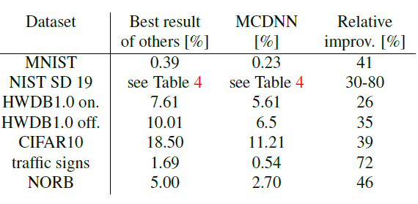
DL is providing breakthrough results in speech recognition and image classification …
From this Hinton et al 2012 paper:
http://static.googleusercontent.com/media/research.google.com/en//pubs/archive/38131.pdf
go here: http://yann.lecun.com/exdb/mnist/
From here:
http://people.idsia.ch/~juergen/cvpr2012.pdf

Slide 3
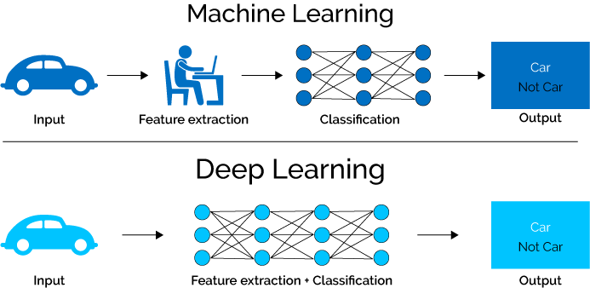
What is Deep Learning (DL) ?
A machine learning subfield of learning representations of data. Exceptional effective at learning patterns.
Deep learning algorithms attempt to learn (multiple levels of) representation by using a hierarchy of multiple layers
If you provide the system tons of information, it begins to understand it and respond in useful ways.
https://www.xenonstack.com/blog/static/public/uploads/media/machine-learning-vs-deep-learning.png

Slide 4
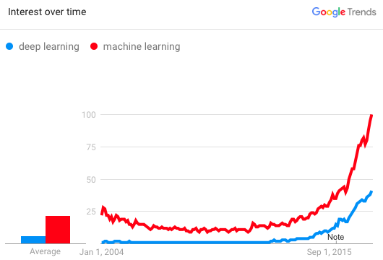
Why is DL useful?
Manually designed features are often over-specified, incomplete and take a long time to design and validate
Learned Features are easy to adapt, fast to learn
Deep learning provides a very flexible, (almost?) universal, learnable framework for representing world, visual and linguistic information.
Can learn both unsupervised and supervised
Effective end-to-end joint system learning
Utilize large amounts of training data
In ~2010 DL started outperforming other ML techniques
first in speech and vision, then NLP

Slide 5
So, 1. what exactly is deep learning ?
And, 2. why is it generally better than other methods on image, speech and certain other types of data?

Slide 6
So, 1. what exactly is deep learning ?
And, 2. why is it generally better than other methods on image, speech and certain other types of data?
The short answers
1. ‘Deep Learning’ means using a neural network
with several layers of nodes between input and output
2. the series of layers between input & output do
feature identification and processing in a series of stages,
just as our brains seem to.

Slide 7
hmmm… OK, but:
3. multilayer neural networks have been around for
25 years. What’s actually new?

Slide 8
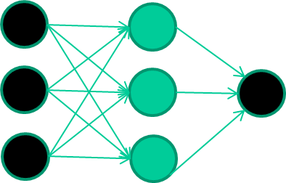
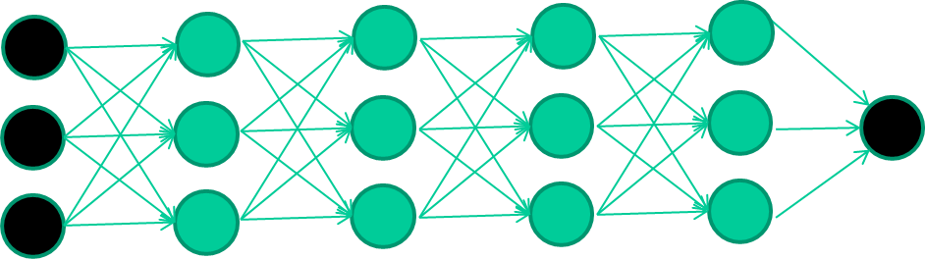
hmmm… OK, but:
3. multilayer neural networks have been around for
25 years. What’s actually new?
we have always had good algorithms for learning the
weights in networks with 1 hidden layer
but these algorithms are not good at learning the weights for
networks with more hidden layers
what’s new is: algorithms for training many-later networks

Slide 9
So: multiple layers make sense

Slide 10
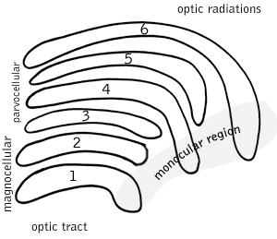
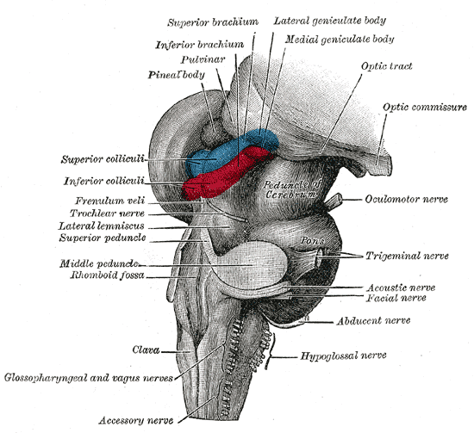
So: multiple layers make sense
Your brain works that way

Slide 11
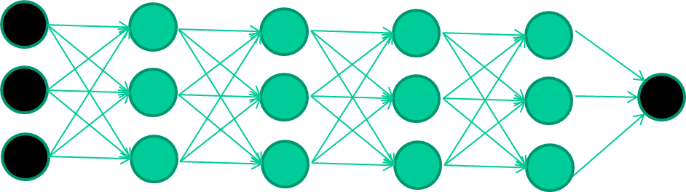
So: multiple layers make sense
Many-layer neural network architectures should be capable of learning the true underlying features and ‘feature logic’, and therefore generalise very well …

Slide 12
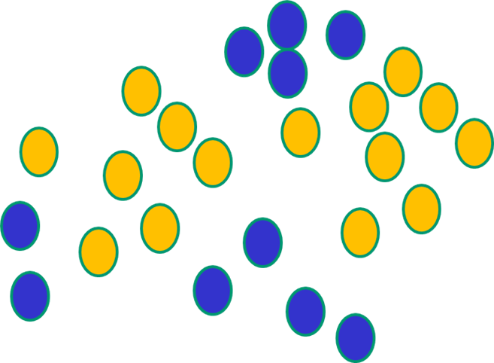

But, until very recently, our weight-learning algorithms simply did not work on multi-layer architectures

Slide 13
Along came deep learning …

Slide 14
The new way to train multi-layer NNs…

Slide 15
The new way to train multi-layer NNs…
Train this layer first

Slide 16
The new way to train multi-layer NNs…
Train this layer first
then this layer

Slide 17
The new way to train multi-layer NNs…
Train this layer first
then this layer
then this layer

Slide 18
The new way to train multi-layer NNs…
Train this layer first
then this layer
then this layer
then this layer

Slide 19
The new way to train multi-layer NNs…
Train this layer first
then this layer
then this layer
then this layer
finally this layer

Slide 20
The new way to train multi-layer NNs…
EACH of the (non-output) layers is trained to be an auto-encoder
Basically, it is forced to learn good features that describe what comes from the previous layer

Slide 21
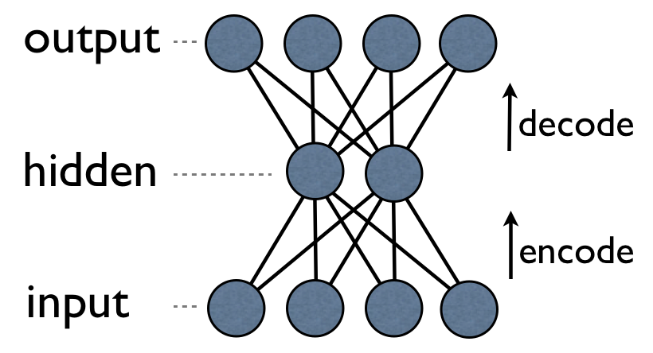
an auto-encoder is trained, with an absolutely standard weight-adjustment algorithm to reproduce the input

Slide 22
an auto-encoder is trained, with an absolutely standard weight-adjustment algorithm to reproduce the input
By making this happen with (many) fewer units than the inputs, this forces the ‘hidden layer’ units to become good feature detectors

Slide 23
intermediate layers are each trained to be auto encoders (or similar)

Slide 24
Final layer trained to predict class based on outputs from previous layers

Slide 25
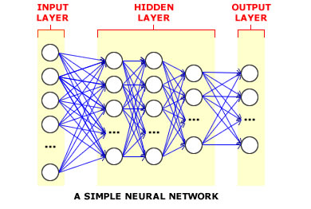
And that’s that
That’s the basic idea
There are many many types of deep learning,
different kinds of autoencoder, variations on architectures and training algorithms, etc…
Very fast growing area …

